Slide 1

Programming Principles and Techniques
ALGORITHM
Notes:
1-13

Slide 2
Learning Outcomes
By the end of this session, you should be able to:
Solve problems using two algorithm representative techniques;
Test the algorithm execution process with step-by-step detailing;and
Build complex algorithm for selection and repetition structures.
Notes:
1-13

Slide 3
Introduction
Algorithm is a step-by-step problem solving method in a limited time.
Two algorithm representations:
  Flowchart:
    Represented by geometry nodes
    Each node represents different activities
    The nodes are joined using arrows to show the flow or sequential activity
  Pseudo-codes
    Pseudo-codes are instructions that mimic the program code.
Notes:
1-13

Slide 4
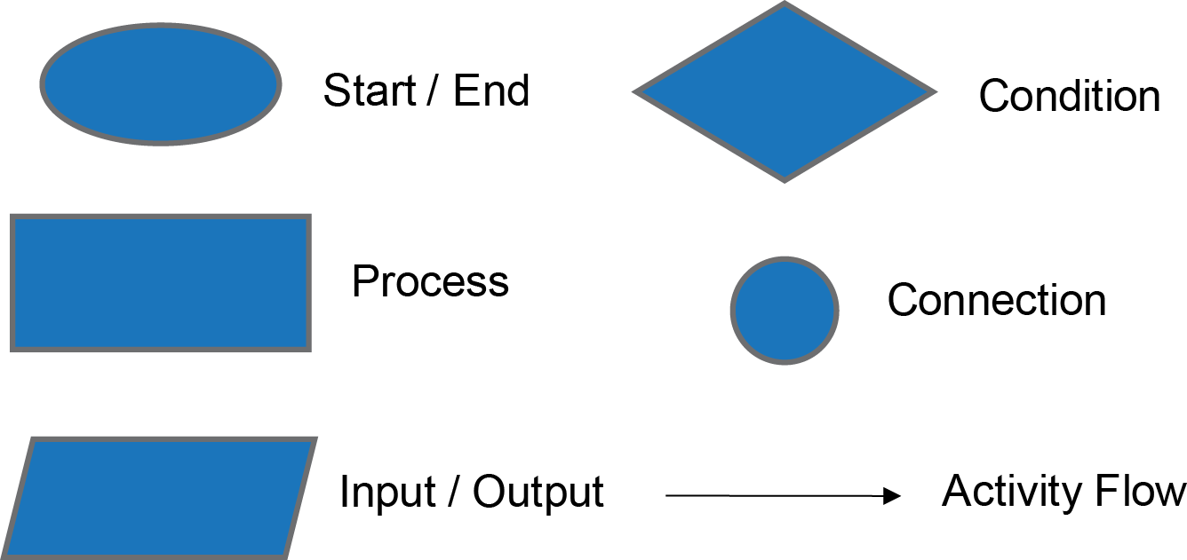
Flowchart
Notes:
1-13

Slide 5
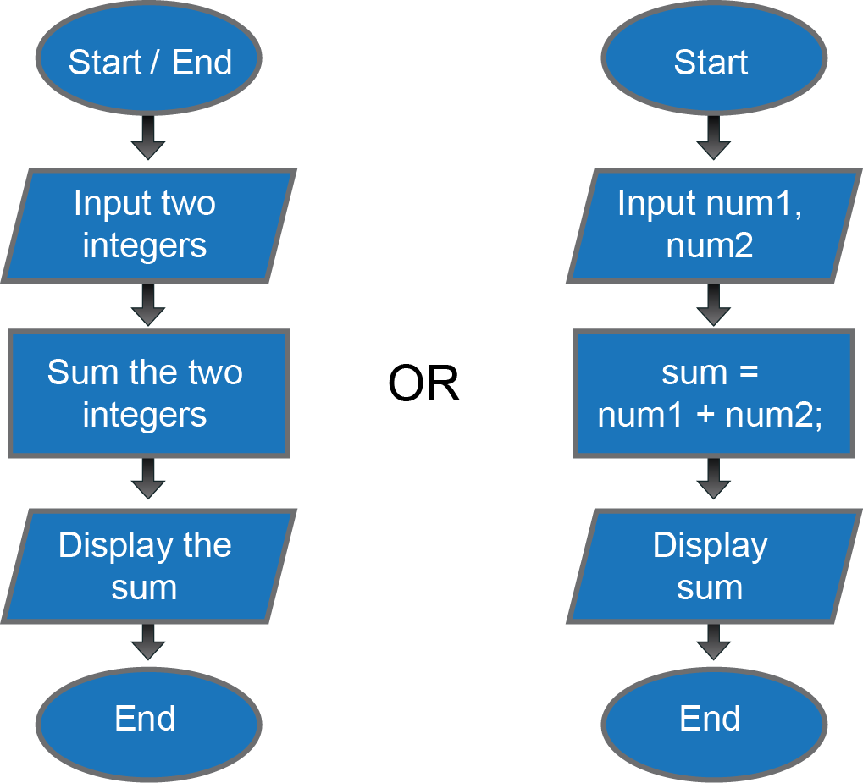
Example
Problem statement: Get two integer numbers, sum the numbers and display the output.
Notes:
1-13

Slide 6
Pseudo-codes
Problem statement: Get two integer numbers, sum the numbers and display the output.
  Pseudo-code:
  1.0 Start
  2.0 Input two integers: num1 and num2
  3.0 Sum the numbers => sum = num1 + num2;
  4.0 Display the sum
  5.0 End
<number> - 13
Notes:
1-13

Slide 7
Algorithm Development Method
Use divide and conquer method.
Guideline to build algorithms:
  Identify the input and output of a problem
  Identify and list the sub-problems. Each problem must be solved in order to get the results needed
  For every sub-problem, identify and list the steps that must be taken to solve it
Notes:
1-13

Slide 8
Selection Structure
Selection structure is a structure design that gives a few choices during execution.
The choices made are dependent of the conditions that are given.
THREE types of general selection structure:
  Single Selection
  Dual Selection
  Multiple Selection
Notes:
1-13

Slide 9
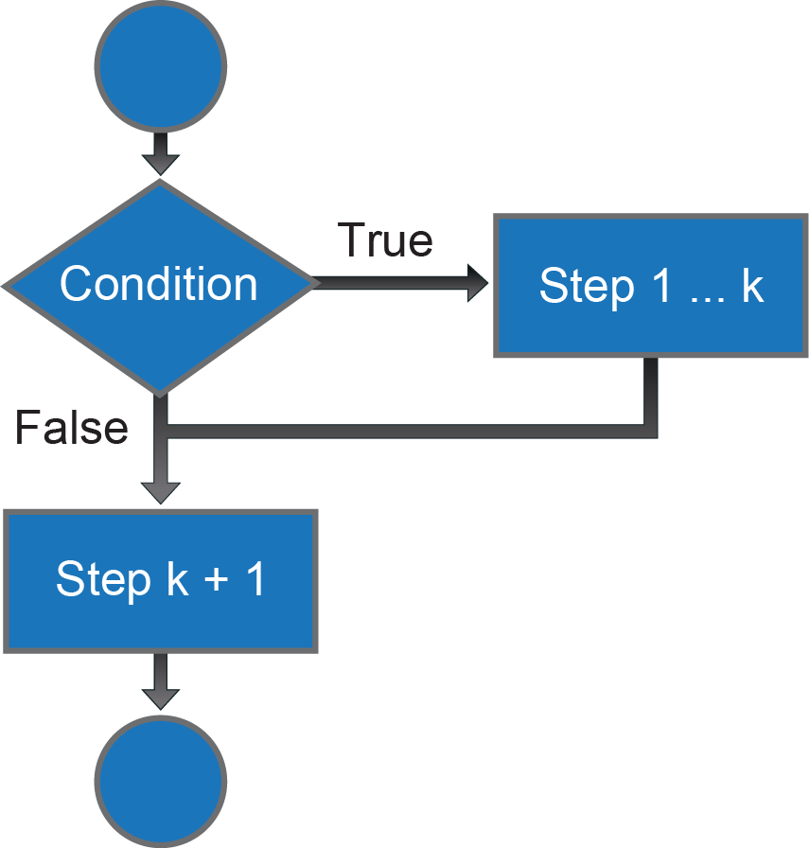
Single Selection
Step a
If <condition true>
Start_If
step 1
step 2
:
step k
End_If
Step k + 1
Flowchart
Pseudo-code
Notes:
1-13

Slide 10
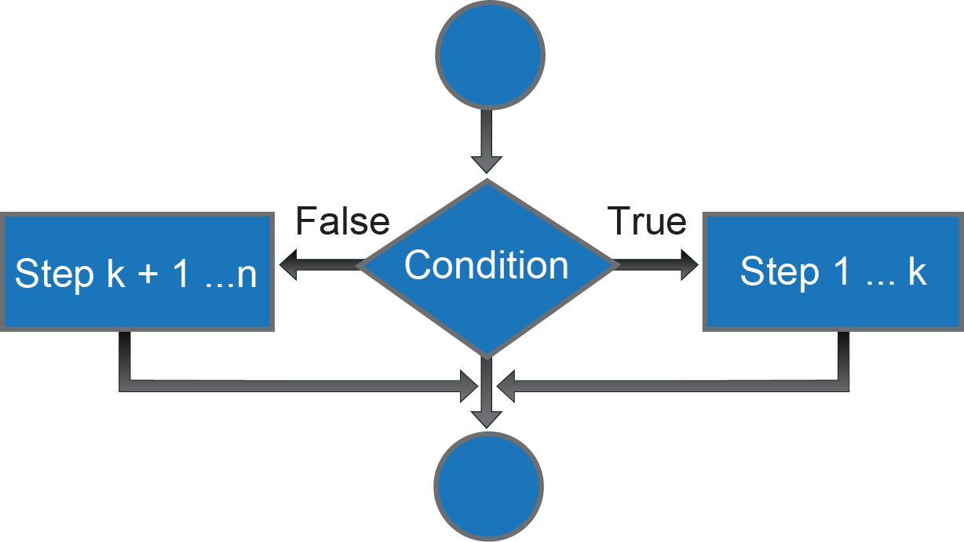
Dual-Selection
If <true condition>
Start
step 1
step 2
:
step k
End_If
If_Not
Start
step k+1
step k+2
:
step n
End_If_Not
Step n + 1
Notes:
1-13

Slide 11
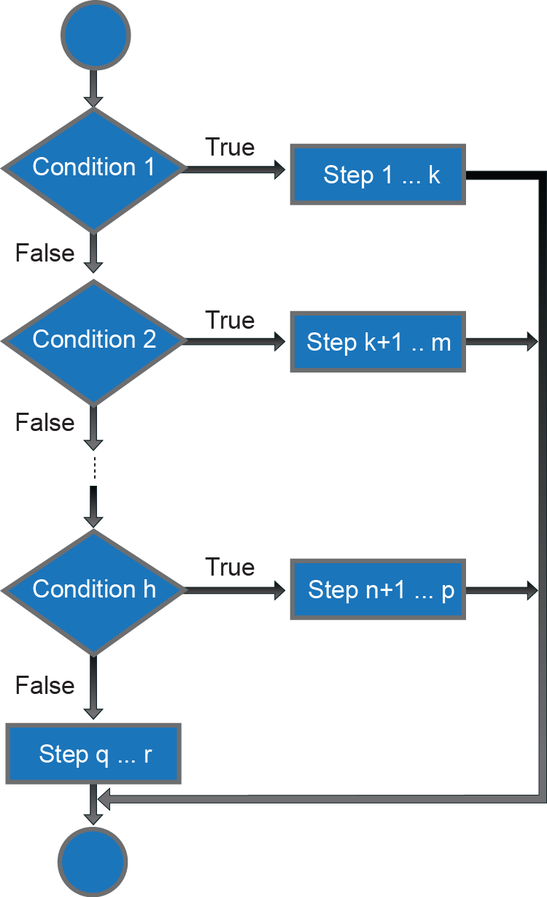
Multi-Selection
If <true condition1>
Start
step 1
step 2
:
step k
End_If1
If_Not
If <true condition2>
Start
step k+1
step k+2
:
step m
End_If2
:
If_Not2
If <true condition h>
Start
step n+1
step n+2
:
step p
End_If h
If_Not
step q
step q+1
:
step r
End_If_Not
Notes:
1-13

Slide 12
Repetition Structure
Repetition structure is a structure where one block of statements is executed repeatedly.
THREE types of general repetition structure:
  Counter controlled loop
  Condition controlled loop
  Sentry controlled loop
Notes:
1-13

Slide 13
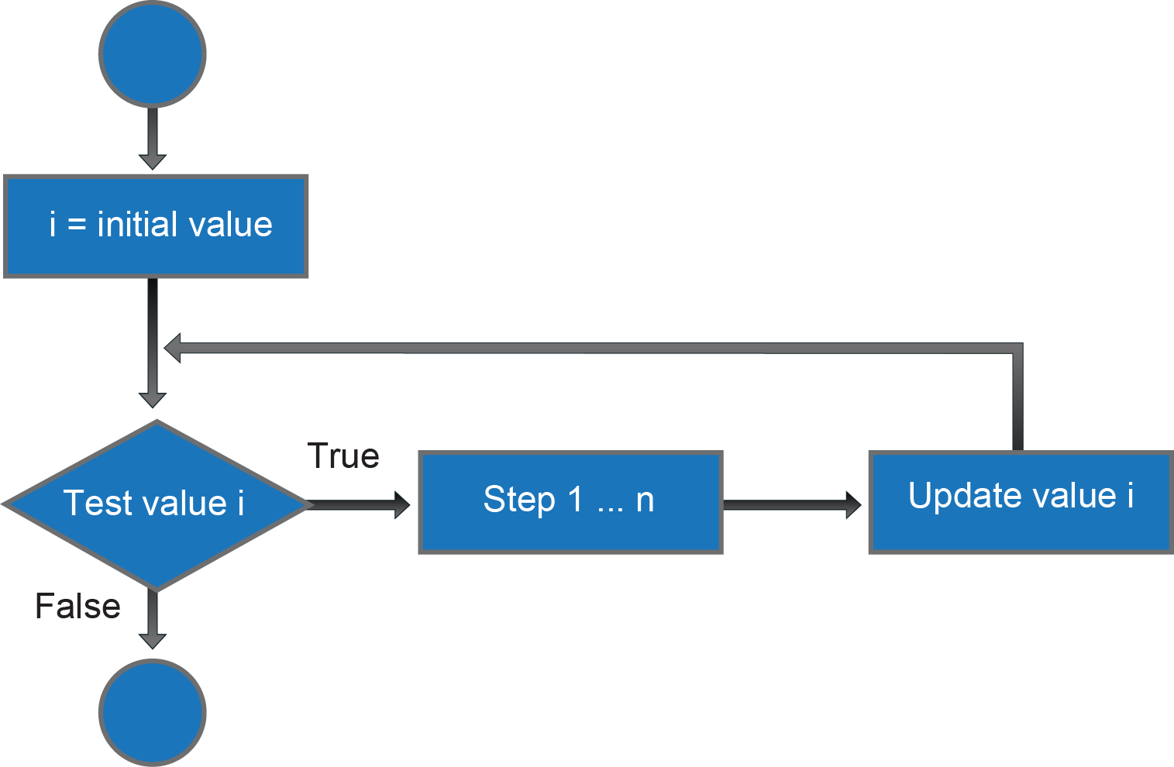
Counter Controlled Loop
Notes:
1-13

Slide 14
Condition Controlled Loop
Loops are controlled by true conditions
There are two types of loops:
  Loops with conditions tested first
  Loops with conditions tested later
Notes:
1-13

Slide 15
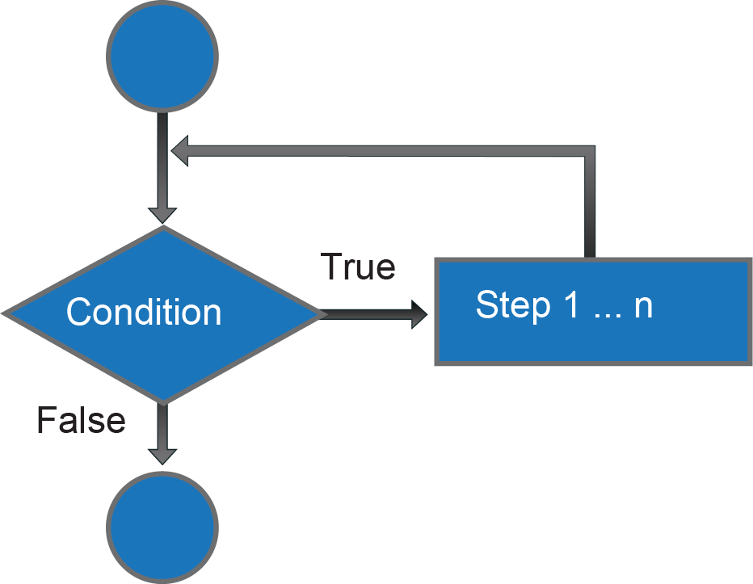
Loops with condition tested first
Notes:
1-13

Slide 16
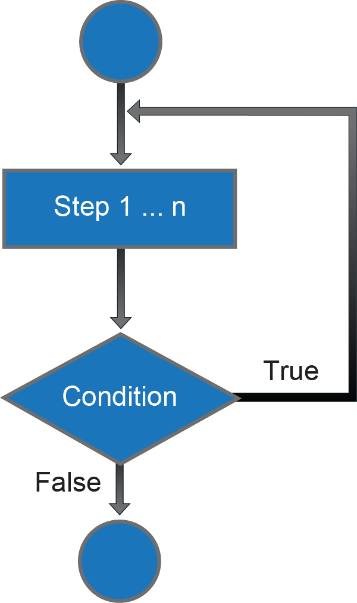
Loops with condition tested later
Notes:
1-13

Slide 17
Sentry Controlled Loop
Loops of this type are actually subset loops controlled by condition.
Sentry value is a signal to stop the loop.
Loops of these are also called uncertain loops because the number of loop executions are not known before the execution starts
Sentry value chosen must not be an input data.
Sentry value can also be of type character.
Notes:
1-13

Slide 18
Summary
Algorithms is a step-by-step problem solving method in a limited time.
Flowchart is represented by geometry nodes. Each node represents different activities and connected by arrows to show the flow of sequential activity.
Pseudo-code are instructions that mimic the program code.
Three components need to identified to solve a problem: input, process and output.
Notes:
1-13

Slide 19
Summary (cont.)
There are three types of selection structures in programming called single selection, dual selection and multiple selection.
There are three types of repetition structures called counter controlled loops, condition controlled loops and sentry controlled loops.
Notes:
1-13

